Slide 1
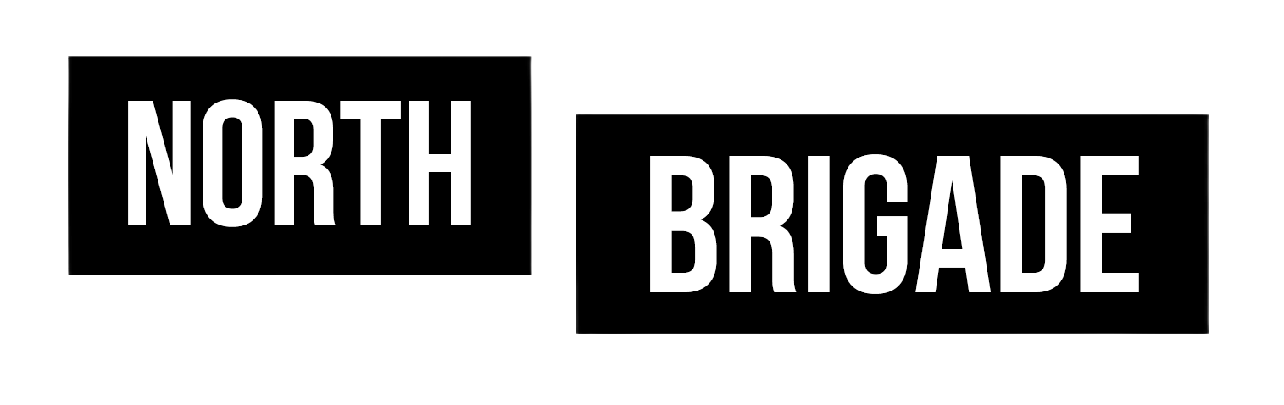
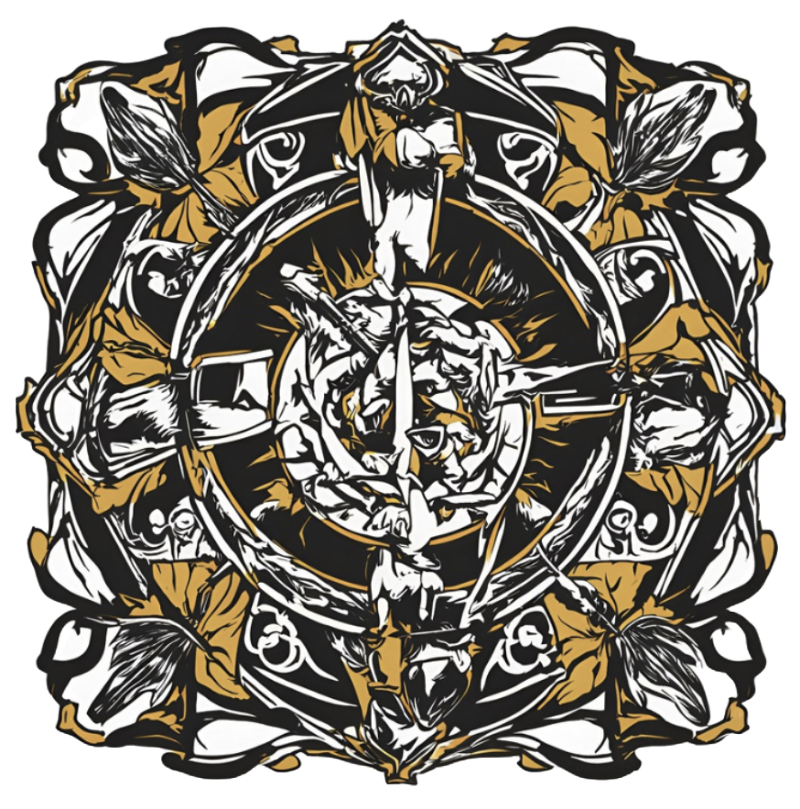
North Brigade
The First Defense
Alex J, William S, Nyan Z, Christopher G, Ryan R, Turjo C

Slide 2
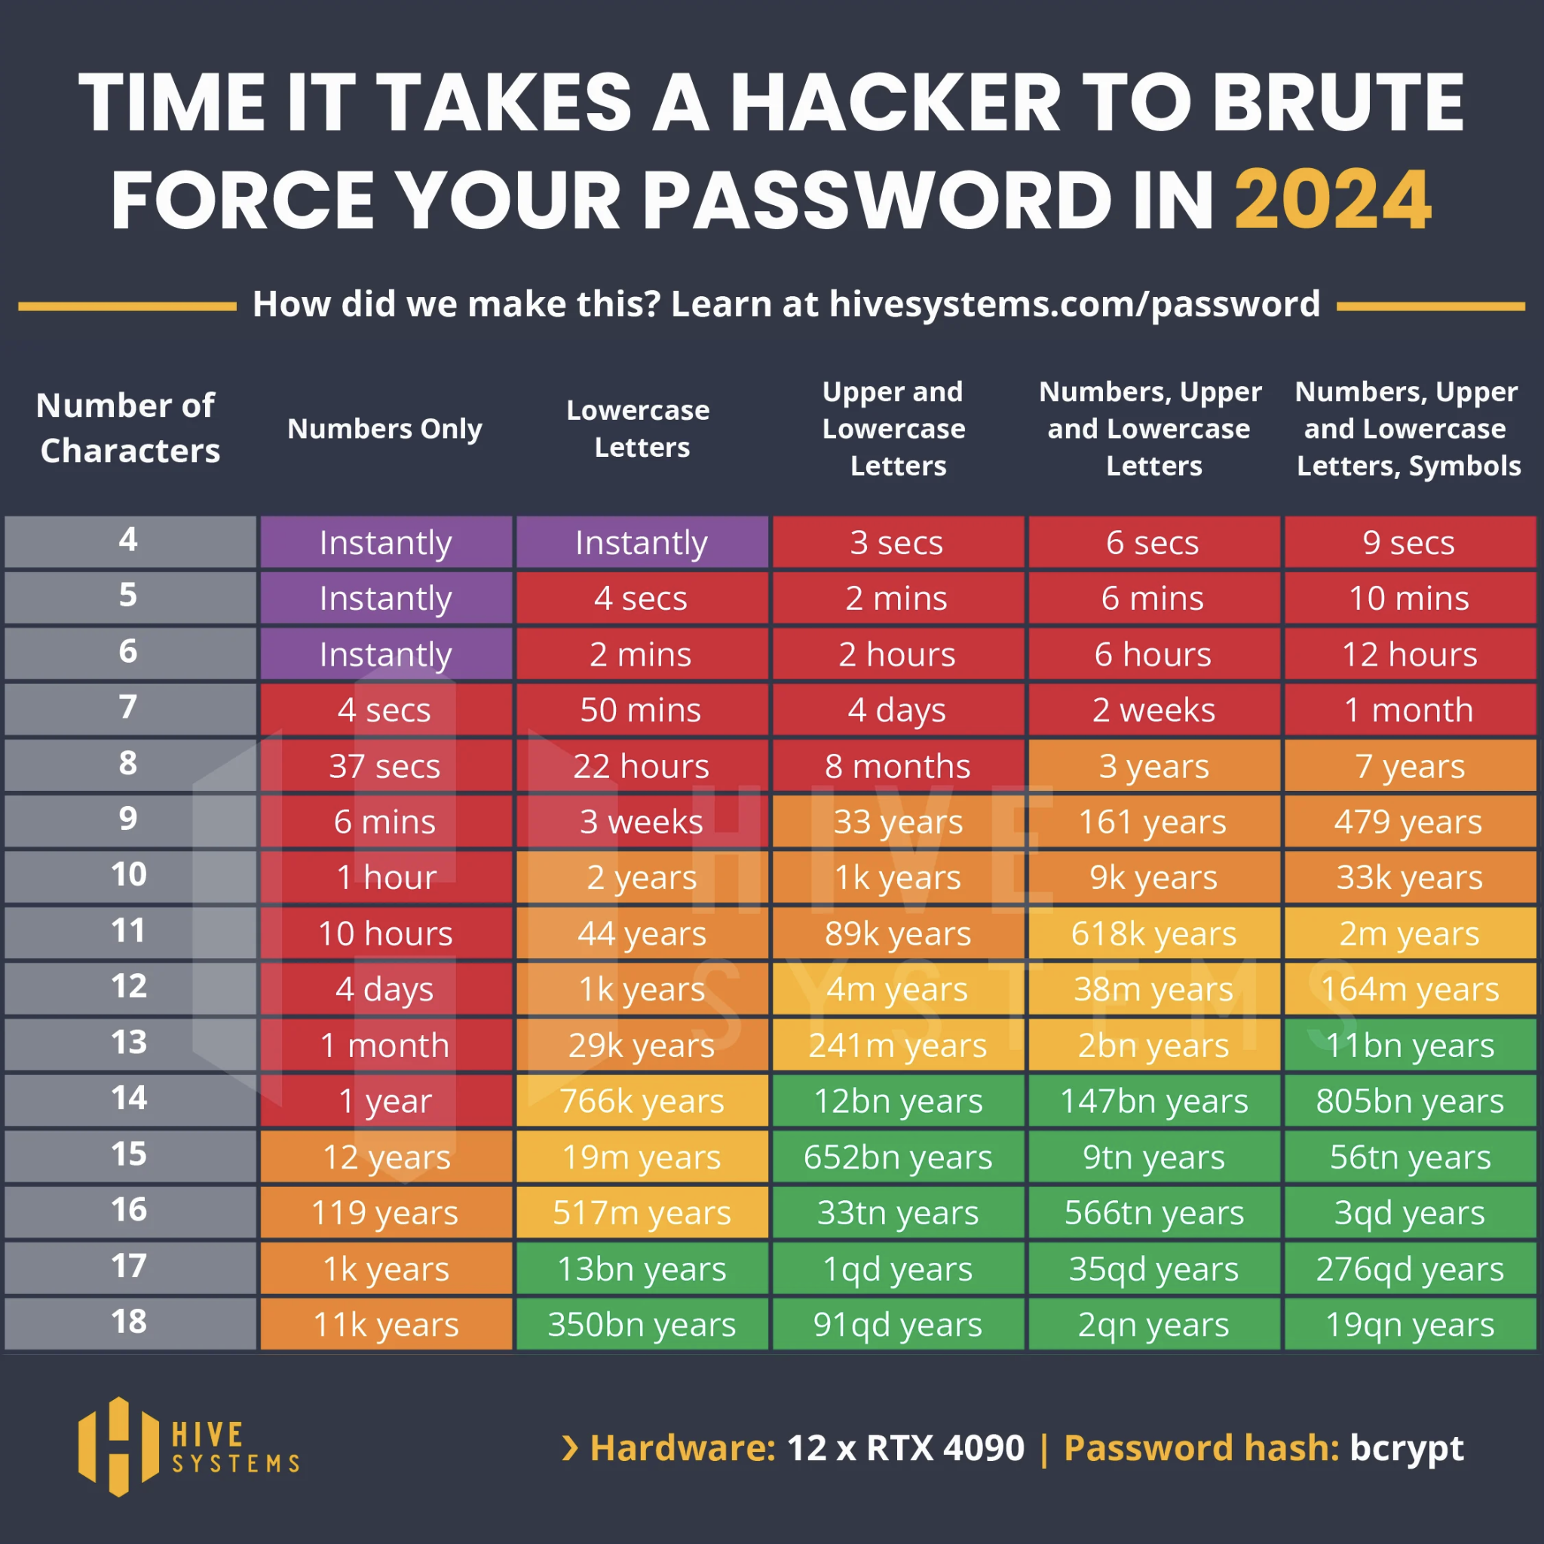
Password In-Security
Data Breaches - Passwords made public
Easy to guess/brute force
Reused Passwords
Weak Encryption passwords
Phishing attacks
Social Engineering
Hive Systems
Notes:
Why is it bad
Passwords are less safe than ever.
Major data breaches have occurred where millions of people’s private emails and passwords have been released to the public.
Some of these may be released in cipher text while others may have had some form of encryption
However, even if a password was encrypted, modern hackers are able to easily brute force or guess a password through repeated trial and error.

Slide 3
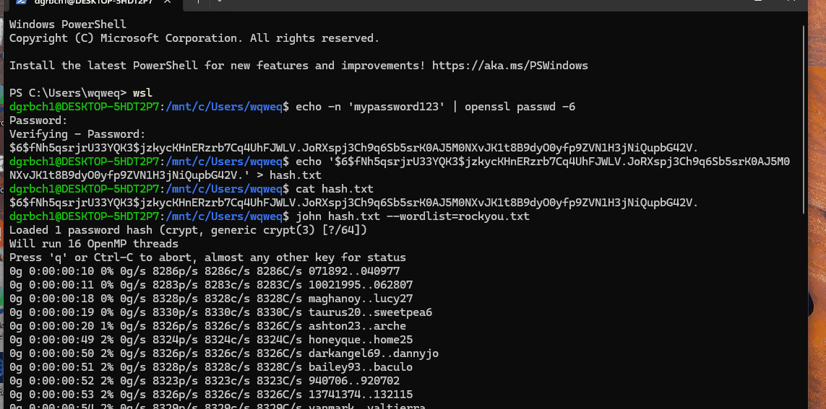
Cracking Passwords with John the Ripper
Notes:
Demo EX: john ripper lab
This slide demonstrates the use of John the Ripper in a Unix environment. The GIF showcases how John the Ripper processes a hashes.txt file using the rockyou.txt wordlist. Over time, it successfully cracks the password, highlighting how weak or predictable passwords, as well as inadequate encryption, can leave sensitive information vulnerable to exposure.

Slide 4
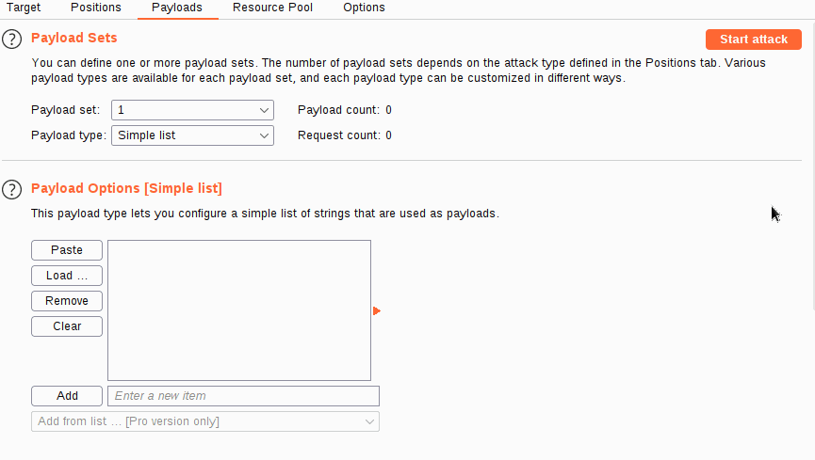
Notes:
Burps suite on a website credit goes to Tryhackme.com. First we capture request of the website.
Insert a worlist of the leaked usernames and insert a series of passwords. Attack is then initiated

Slide 5
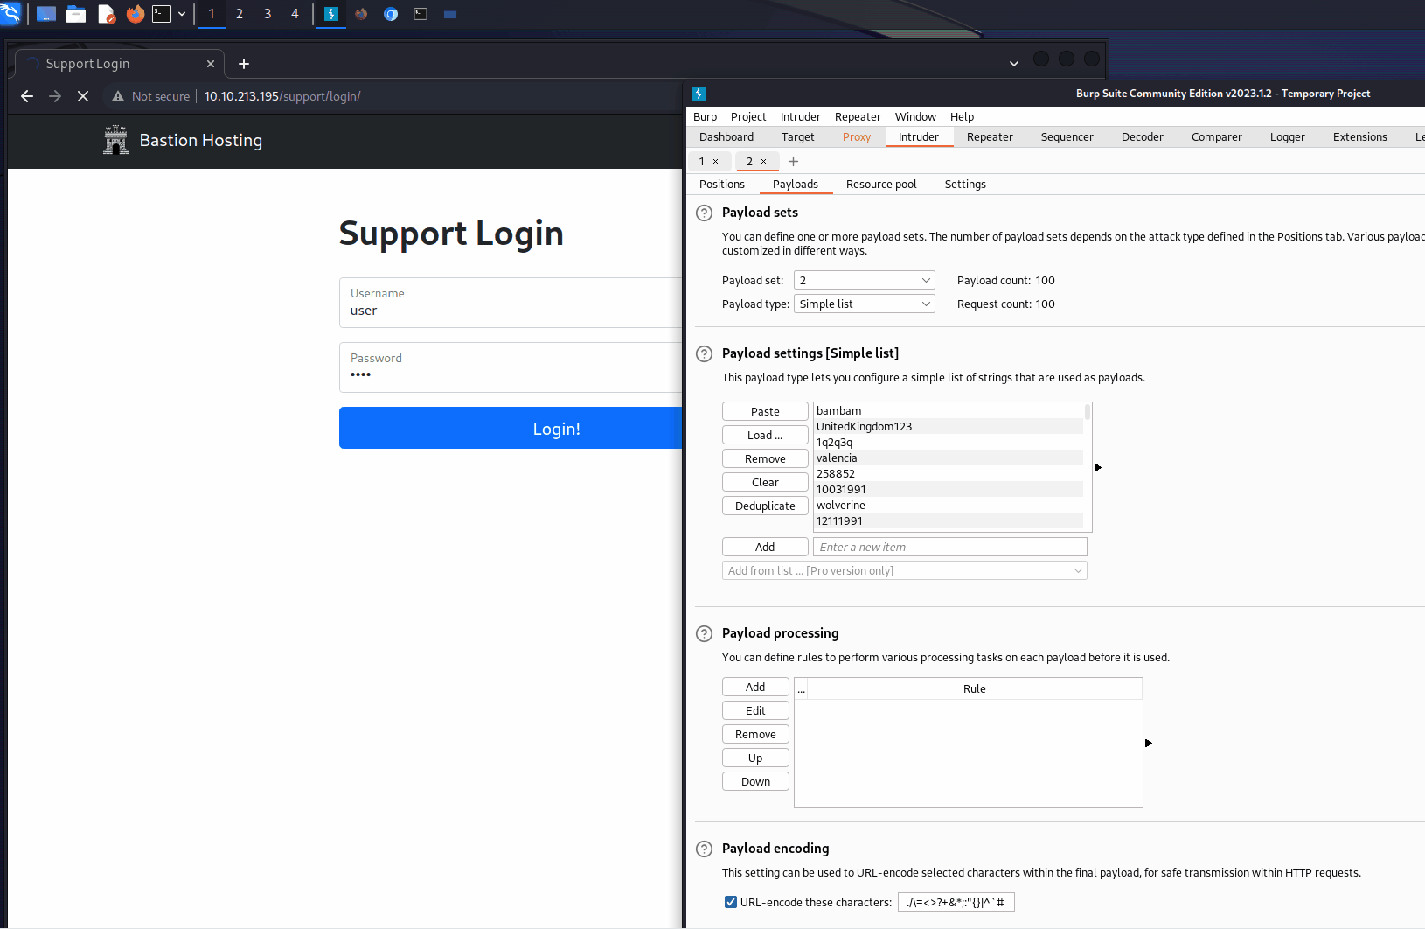
Notes:
Once the attack is made we pay attention to the status code there is no change so we look at the length we find one user and pass with a different length. WE FOUND A MATCH

Slide 6
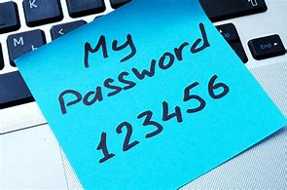
Solution
Randomly Generate passwords with Uppercase, lowercase, numbers, and symbols.
- Hard to guess and bruteforce
Multi-Factor Authentication
Change passwords every 3 months that auto-update to password manager
Password Managers Store and manage complex passwords using trusted password manager tools
Train and Educate people on strong passwords
Don’t reuse passwords across multiple accounts
Notes:
Solution

Slide 7
Additional Features
Password Manager (Top Grade Encryption) - So the user doesn’t forget their complicated passwords and have them all in one place
Multi Factor authentication - Alerts the user when a sign in is attempted, and can ensure the proper user gains access to the website
Notes:
Solution

Slide 8
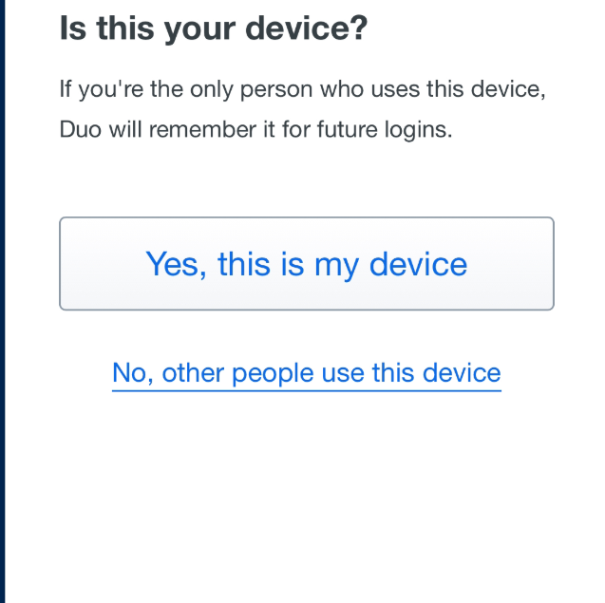
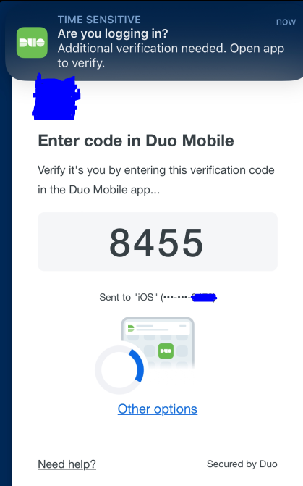
Multi Factor authentication

Slide 9
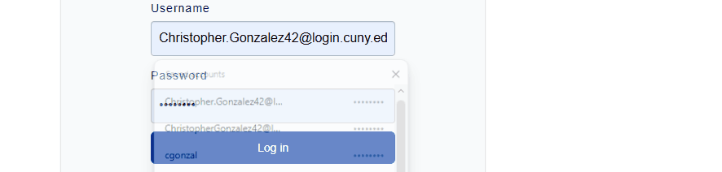
Demo (Ease of Password Manager)
Notes:
Demo EX: password manager, multi factor authentication being used / how to use, if able to create a code that stops user from creating small passwords/

Slide 10
Information regarding Advice and past incidents
Tech.co. "Weak and Strong Password Examples." Tech.co, https://tech.co/news/weak-strong-password-examples. Accessed 22 Nov. 2024.
Stay Safe Online. "Passwords: Securing Your Accounts." National Cybersecurity Alliance, https://staysafeonline.org/online-safety-privacy-basics/passwords-securing-accounts/. Accessed 22 Nov. 2024.
National Cyber Security Centre. "Using Passwords." Exercise in a Box, https://www.ncsc.gov.uk/section/exercise-in-a-box/using-passwords. Accessed 22 Nov. 2024.
CyberNews. "RockYou2024: Largest Password Compilation Leak." CyberNews, https://cybernews.com/security/rockyou2024-largest-password-compilation-leak/. Accessed 22 Nov. 2024.
Expert Insights. "The Most Significant Password Breaches." Expert Insights, https://expertinsights.com/insights/the-most-significant-password-breaches/. Accessed 22 Nov. 2024.
TryHackMe. "Cyber Security Training." TryHackMe, https://tryhackme.com/. Accessed 22 Nov. 2024.

